Slide 1
Comprehensive Digital Marketing
Project Work On
HALDIRAM’S
TEAM MEMBERS:
PITHANI TEJASREE
RUBY BHANU
P.V.SRAVAN KUMAR
S HARISH

Slide 2

Part 1: Brand study, Competitor Analysis & Buyer’s/Audience’s Persona
COMPANY/TOPIC FOR PROJECT : HALDIRAM’S
Research Brand Identity: Study the brand's mission, values, vision, and unique selling propositions (USPs).
BRAND COLOUR: RED & YELLOW
LOGO:
MISSION/VALUES:
Haldiram’s vision and mission is to review, recreate and rediscover the trend of healthy eating and innovate and invent fresh new methods to nourish and delight everyone we serve. To provide our customers perfect taste and quality in best of packaging.

Slide 3
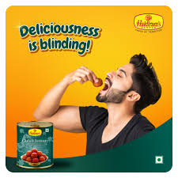
USP : The USP of Haldiram’s is providing wide range of hygienic, tasty and authentic Indian savories and sweets.
TAGLINE: “Delicious bhi Dooriyaanbhi” / Don’t eat at home today; Always in good taste.
Brand Messaging : As Classics as your Taste
https://www.instagram.com/p/CurOGWLorxF/?igshid=MzRlODBiNWFlZA==

Slide 4
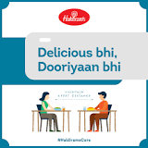
Part 1: Brand study, Competitor Analysis & Buyer’s/Audience’s Persona
Analyze Brand Messaging: Haldiram's brand messaging often highlights its rich heritage and deep-rooted Indian traditions. Haldiram's consistently communicates its commitment to maintaining high standards of quality and purity in its products.
They offer a wide variety of sweets, snacks, namkeens, and ready-to-eat meals, appealing to different tastes and preferences. Haldiram's often highlights the authentic taste and rich flavors of their products. In India, sweets and snacks play a significant role in celebrations and festivals.
Examine the brand's tagline:
Delicious bhi Dooriyaan bhi”
SLOGAN : Taste of Tradition

Slide 5
Part 1: Brand study, Competitor Analysis & Buyer’s/Audience’s Persona
Competitor Analysis: Select three competitors operating in the same industry or niche as the chosen brand, examine their USPs and online communication.
Competitor 1: In snacks segment PepsiCo
http://www.pepsico.com/
USP: "I bet you can't eat just one".
COMMUNICATION : Celebrity endorsements, social media campaigns,
and sponsorships of major sports events.
Competitor 2: In Biscuits Segement Britannia
http://britannia.co.in/

Slide 6
USP: India’s very own bakery and dairy products brand that is trusted for its quality
COMMUNICATION : Advertisements for Television, print media and billboards
Competitor 3 : In Sweets Segement Bikanervala
https://bikanervala.com/
USP: Good quality, fresh, hygienic and tasty Indian sweets and snacks.
COMMUNICATION: During the festive season of Holi, Bikano came up with 50 gram extra with 200
gram offer on its entire range of Namkeens.
nkfnvn

Slide 7
Part 1: Brand study, Competitor Analysis & Buyer’s/Audience’s Persona
Buyer's/Audience's Persona: Clearly define the target audience for the chosen brand. Consider demographics, psychographics, behaviors, and interests.
Demographics:
Age: Haldiram's target audience primarily includes individuals of all age groups, from children to seniors. Different product categories cater to various age segments.
Gender: Both males and females enjoy Haldiram's products, as they offer a wide range of snacks and sweets that appeal to diverse preferences.
Location: While Haldiram's has a global presence, its primary target audience is individuals residing in India and the Indian diaspora around the world.
Income: The brand caters to a broad range of income levels, offering affordable snacks for budget-conscious consumers and premium options for those seeking luxury treats.

Slide 8
Psychographics:
Indian Cuisine Enthusiasts: Haldiram's appeals to individuals who appreciate and cherish the authentic flavors of Indian cuisine and are keen to explore traditional delicacies.
Health-Conscious Consumers: With an increasing focus on healthier snacking options, Haldiram's has adapted its product range to include low-fat and gluten-free alternatives, appealing to health-conscious consumers.
Celebration and Festivity Lovers: Haldiram's products are popular choices during festivals, celebrations, and special occasions, attracting individuals looking to add a touch of tradition and joy to their gatherings
Behaviors:
Repeat Buyers: Haldiram's has a loyal customer base, with people often coming back for their favorite snacks and sweets.
Occasional Indulgers: While some customers buy Haldiram's products regularly, others indulge occasionally, making purchases during festivals, family gatherings, or as gifts.

Slide 9
Online Shoppers: With the rise of e-commerce, Haldiram's targets customers who prefer the convenience of online shopping to purchase their products.
Interests:
Indian Culture and Heritage: Those interested in exploring Indian culture and heritage through its culinary offerings are likely to be drawn to Haldiram's.
Foodies and Snack Enthusiasts: Haldiram's appeals to food enthusiasts, especially those with a penchant for snacks, sweets, and traditional Indian delicacies.
Overall, Haldiram's target audience encompasses a wide spectrum of individuals, united by their appreciation for the rich flavors of Indian cuisine. The brand caters to various age groups, income levels, and interests, making it a versatile choice for consumers looking to experience the essence of Indian culinary delights.
UIHDEDU

Slide 10
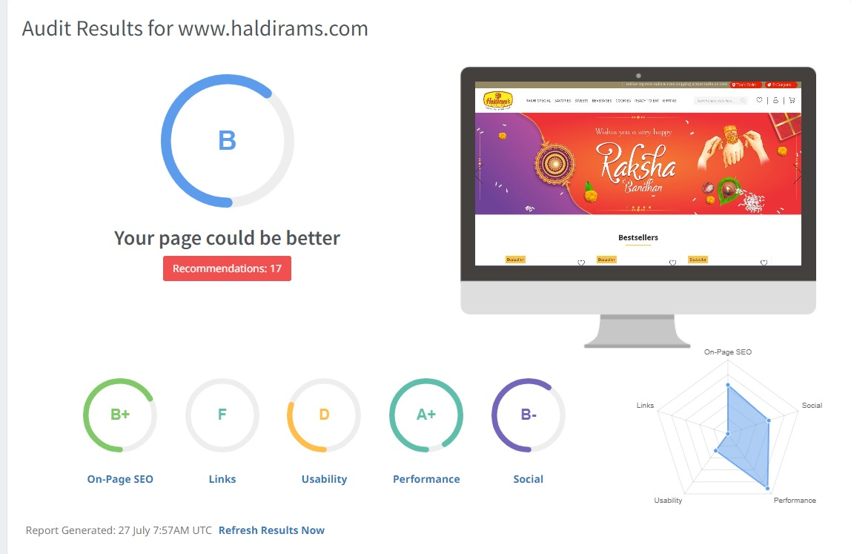
Part 2: SEO AUDIT

Slide 11
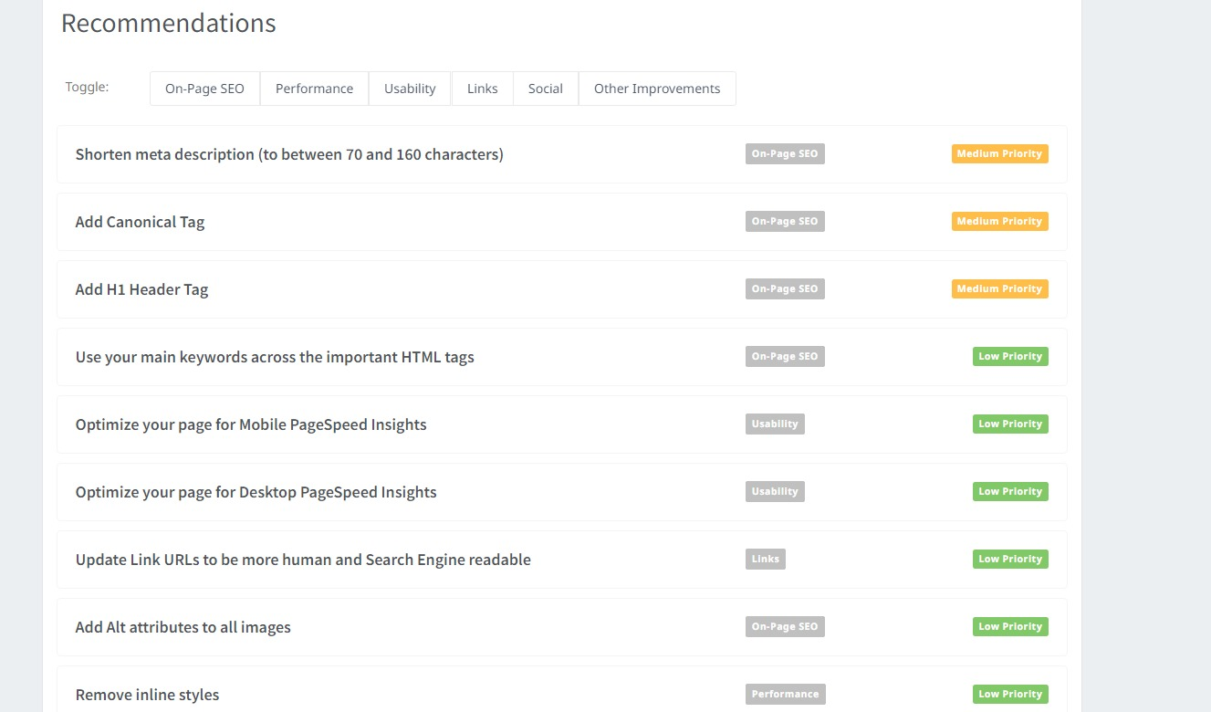

Slide 12
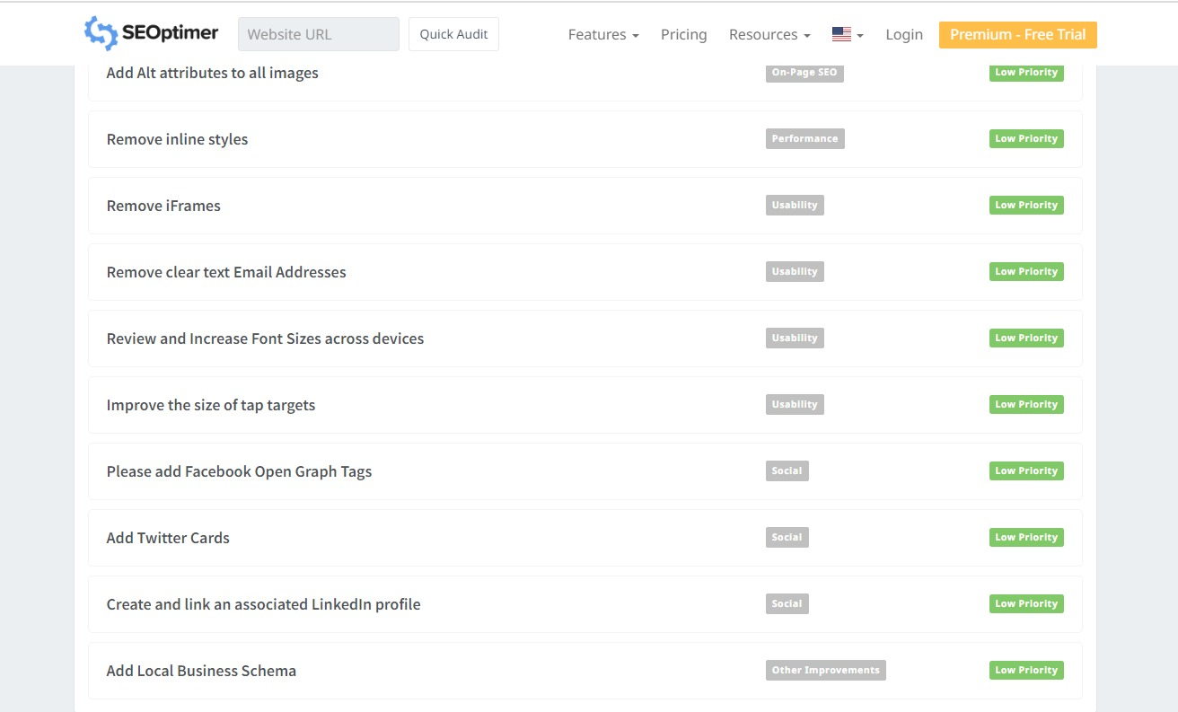

Slide 13
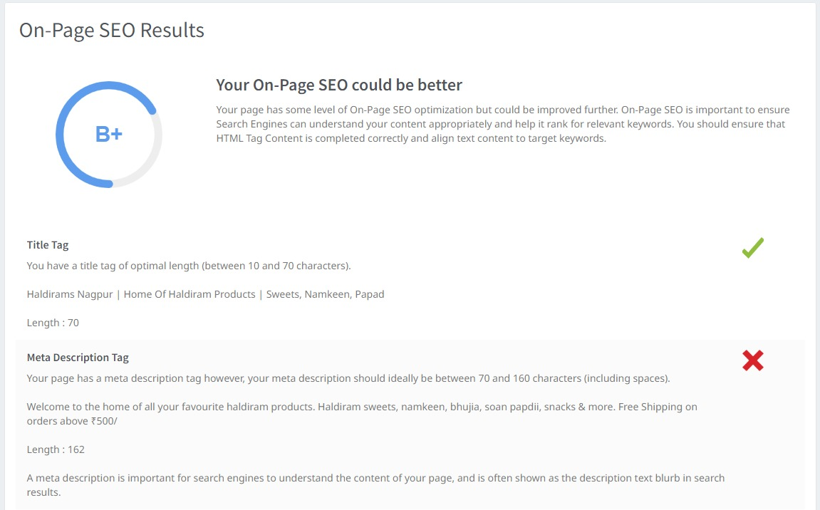

Slide 14
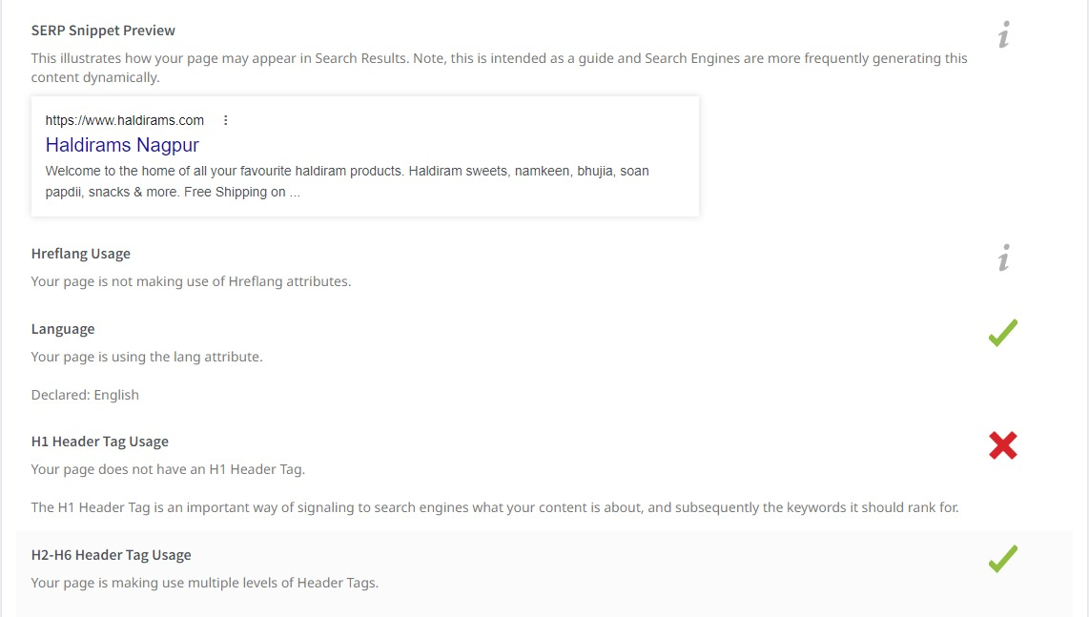

Slide 15
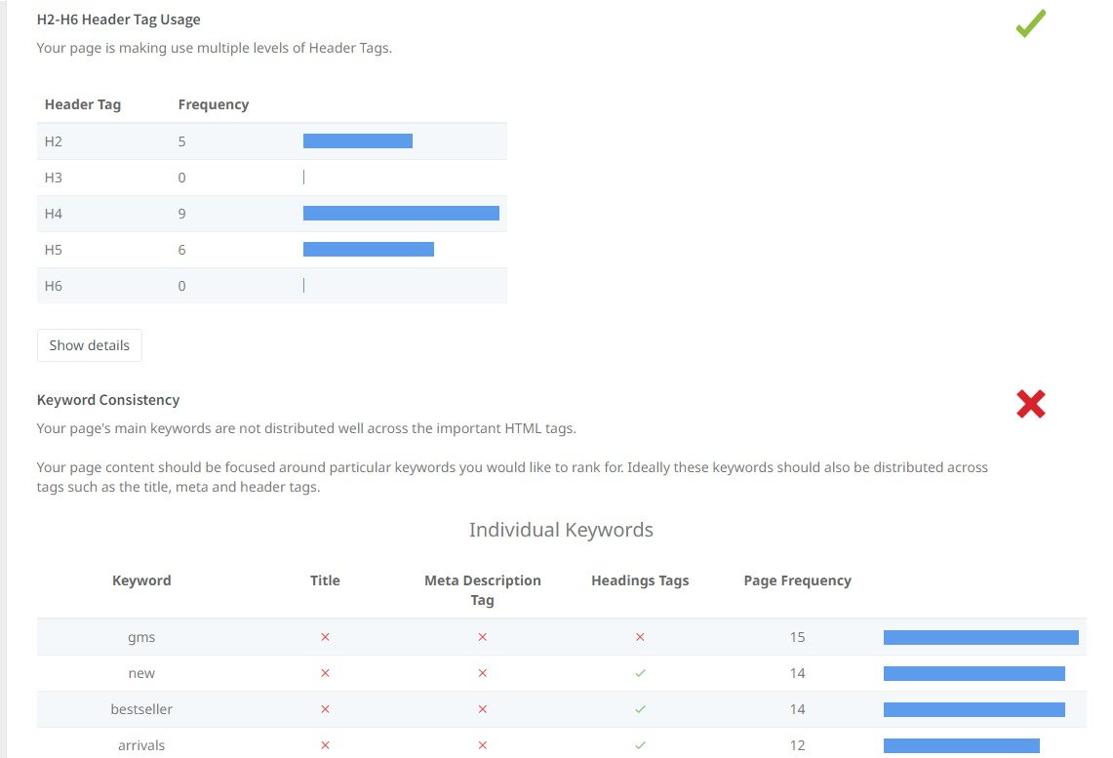

Slide 16
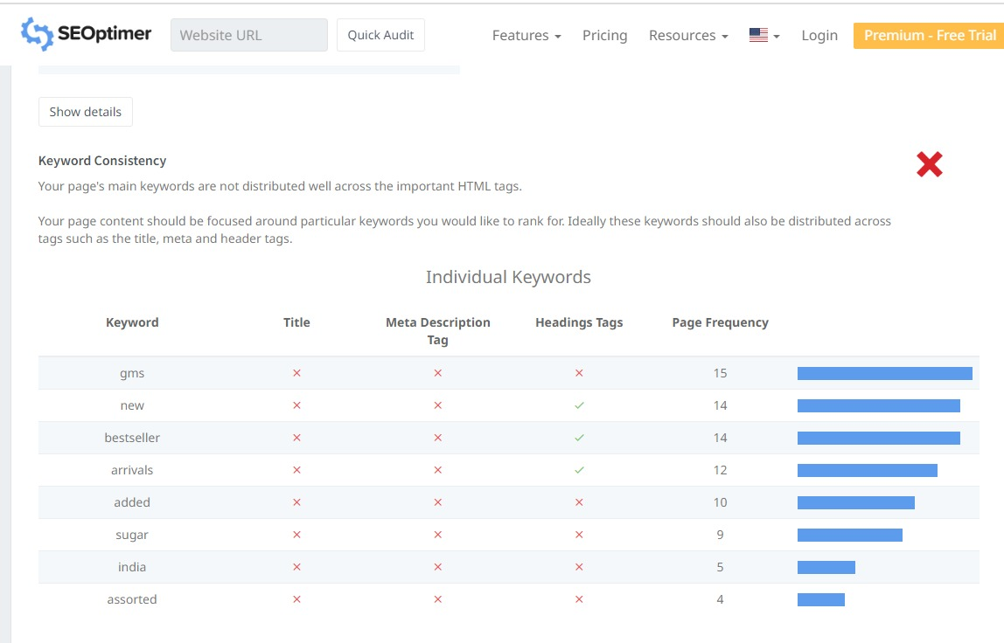

Slide 17
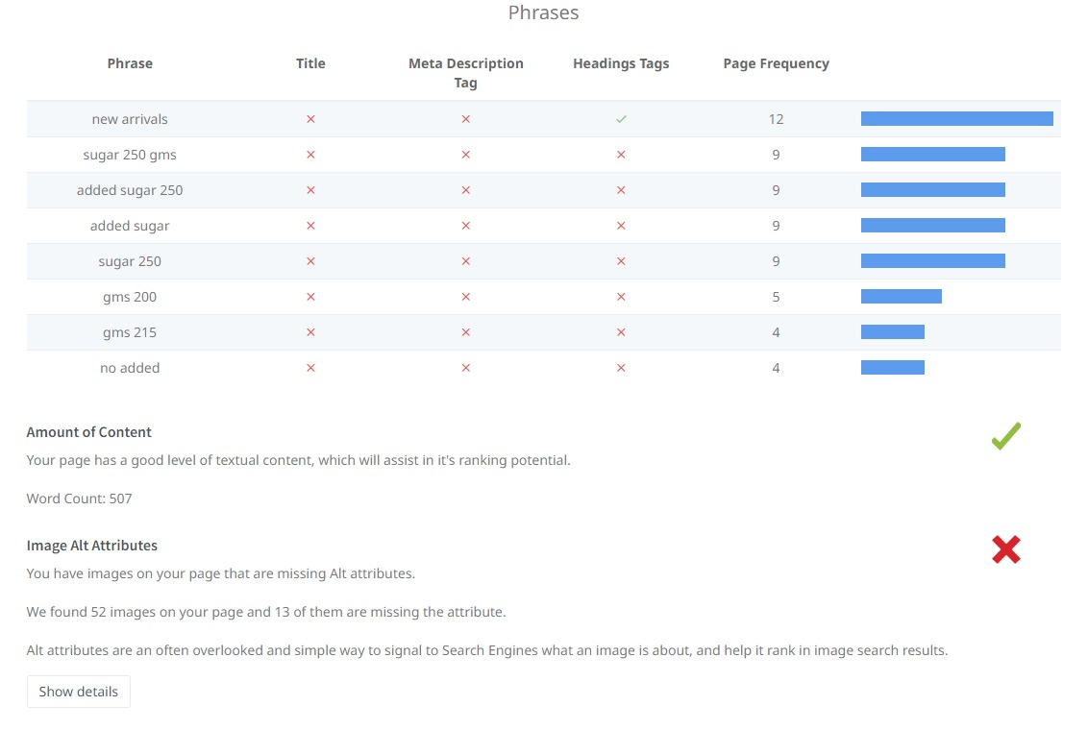

Slide 18
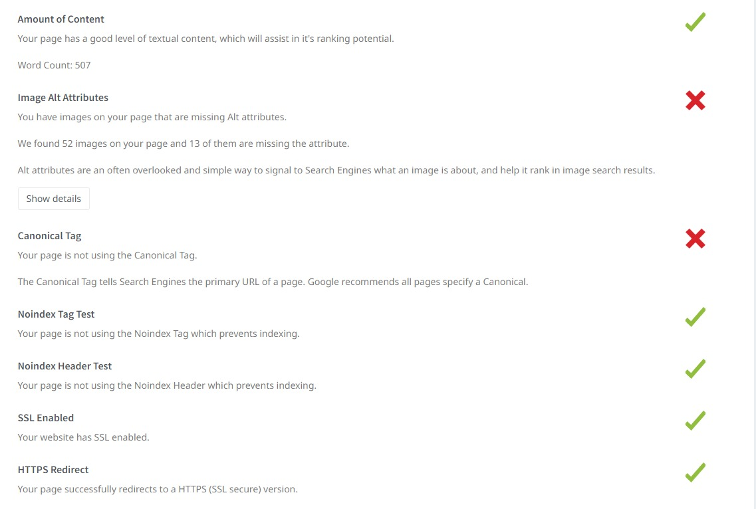

Slide 19
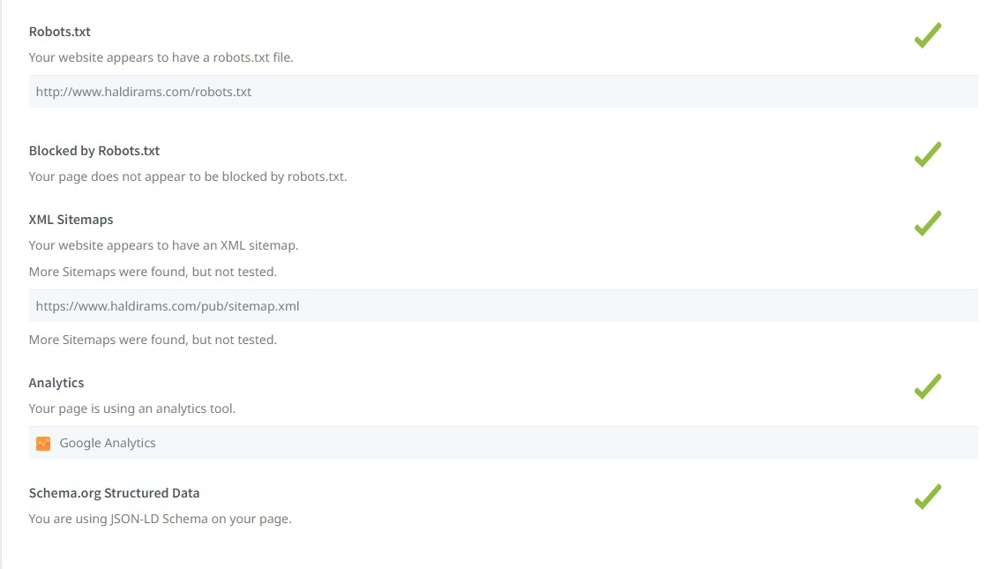

Slide 20
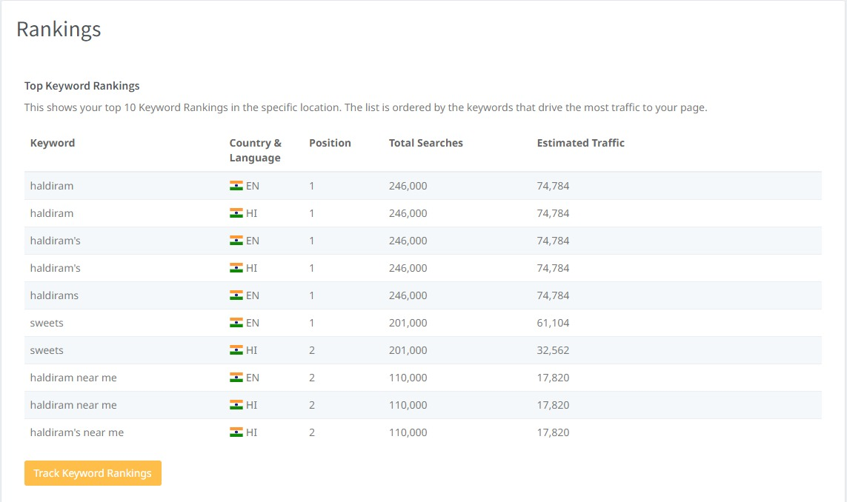

Slide 21
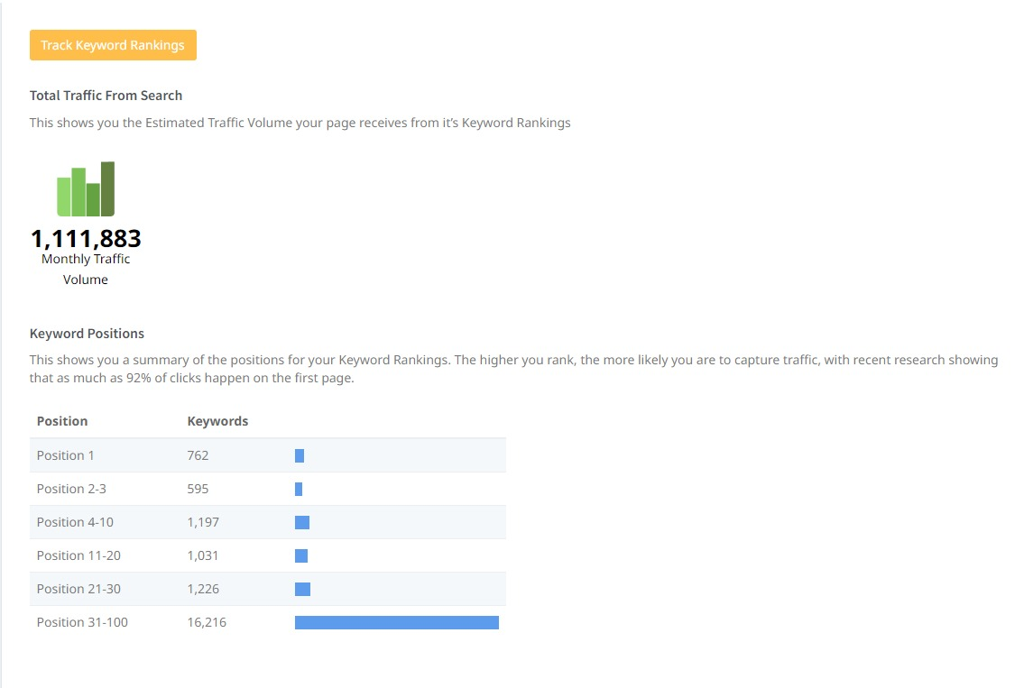

Slide 22
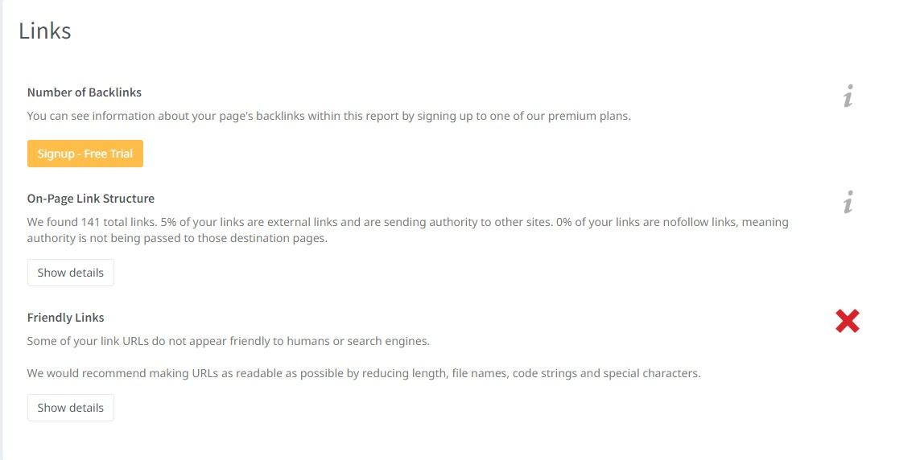

Slide 23
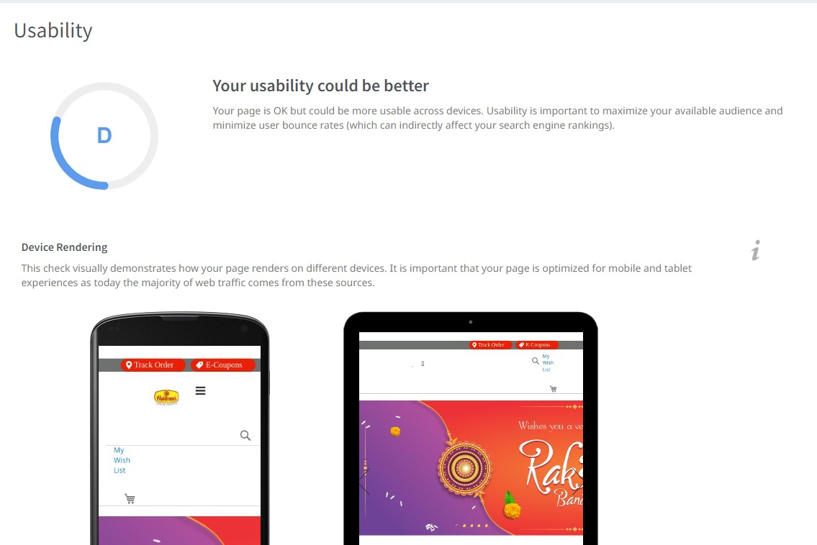

Slide 24
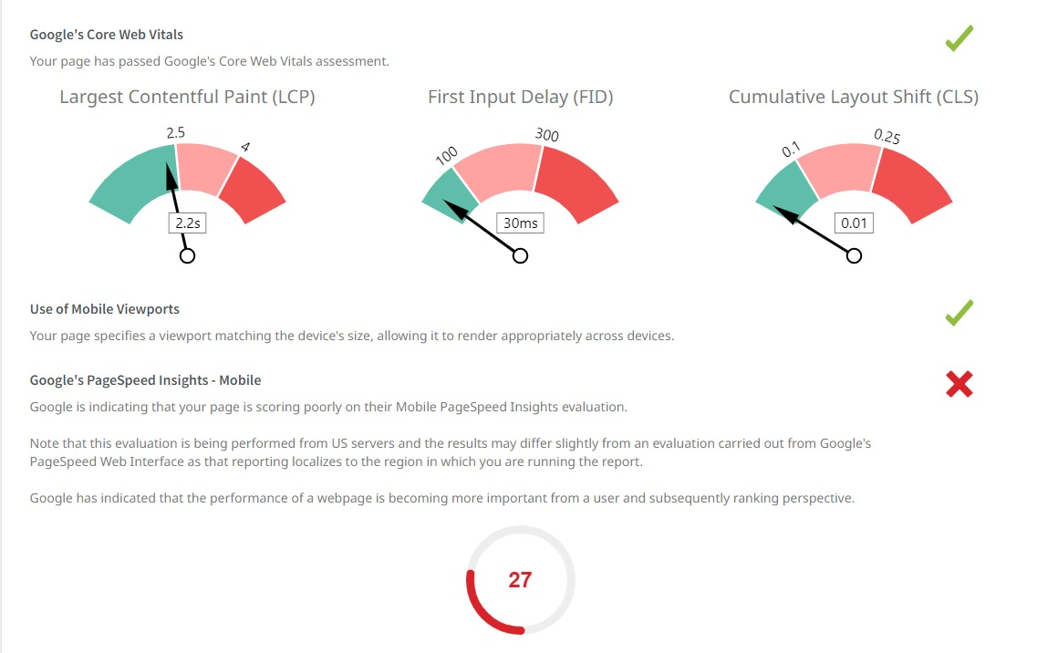

Slide 25
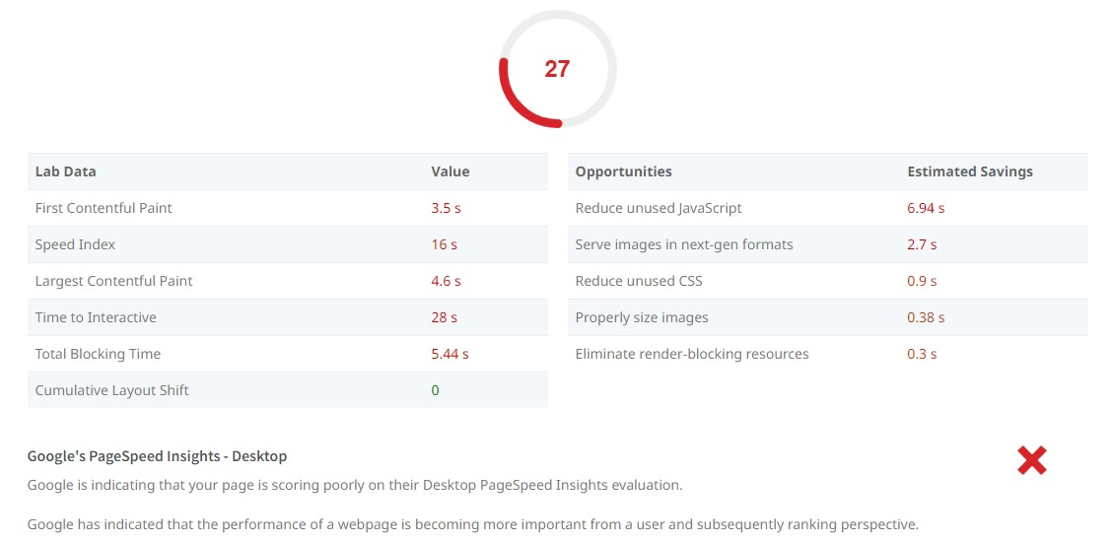

Slide 26
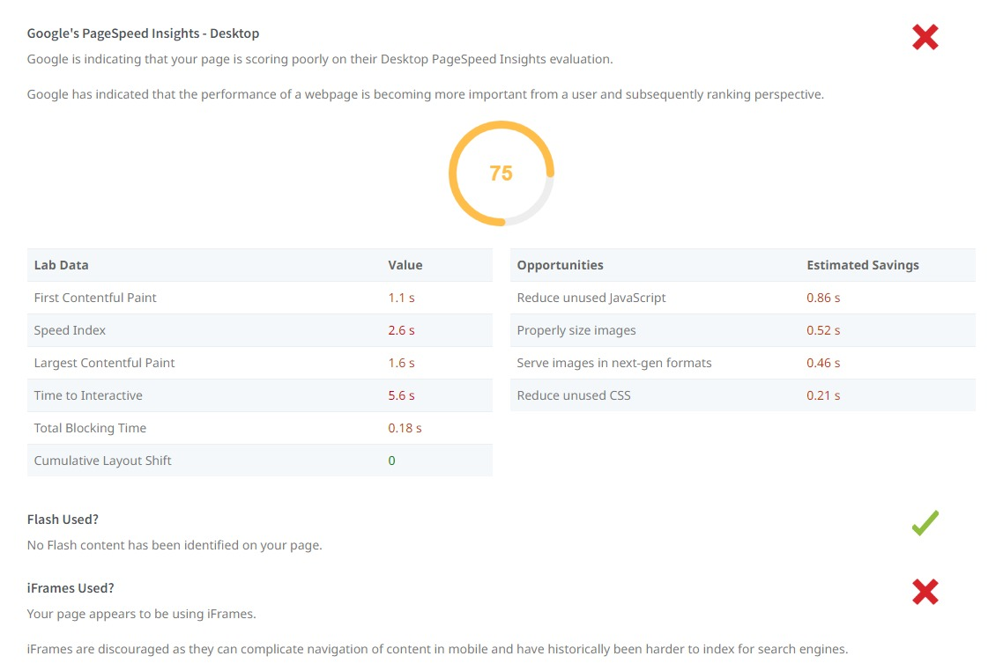

Slide 27
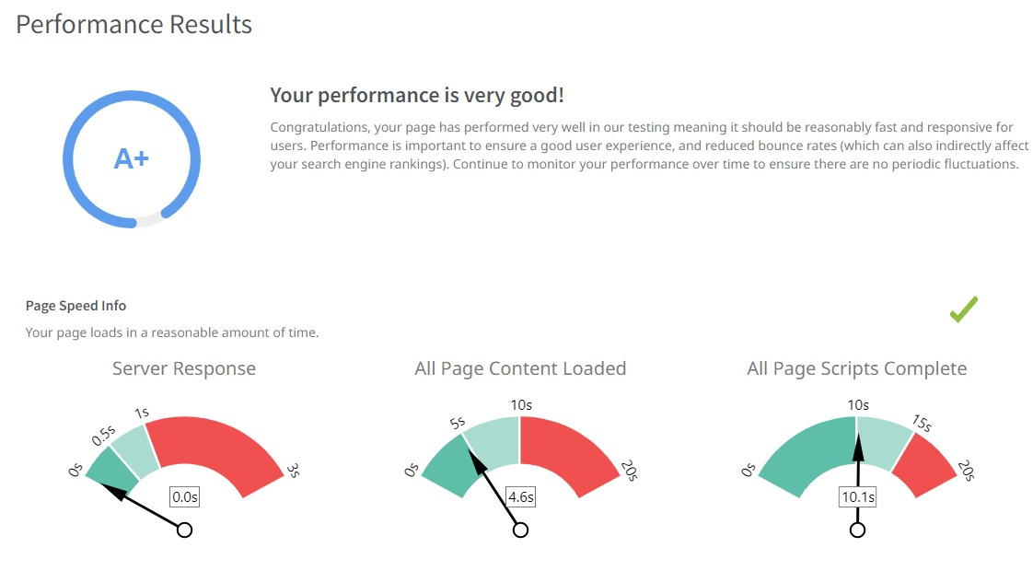

Slide 28
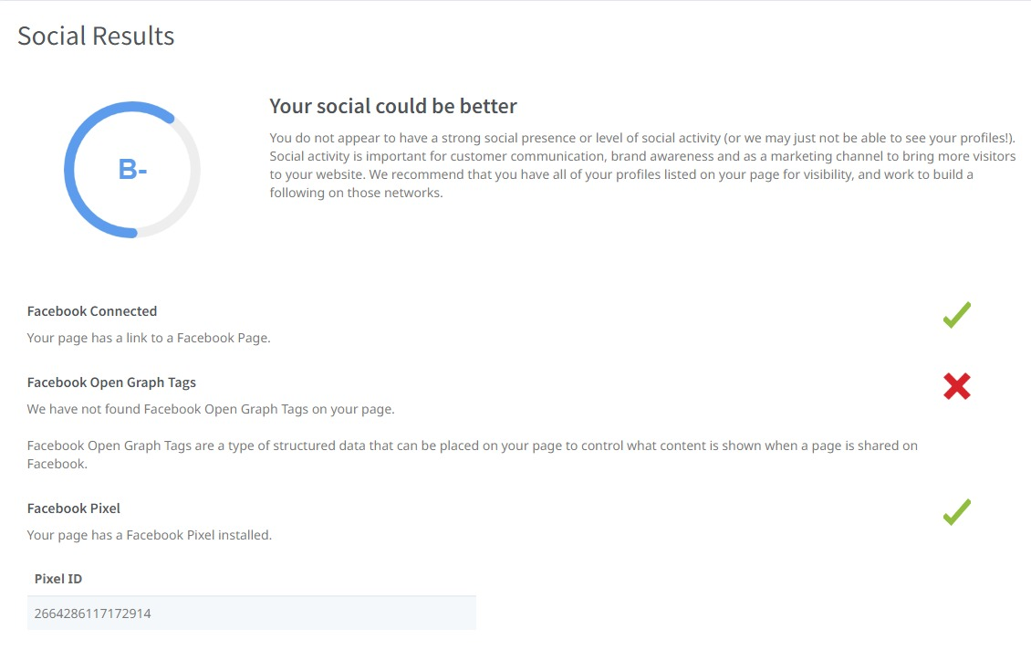

Slide 29
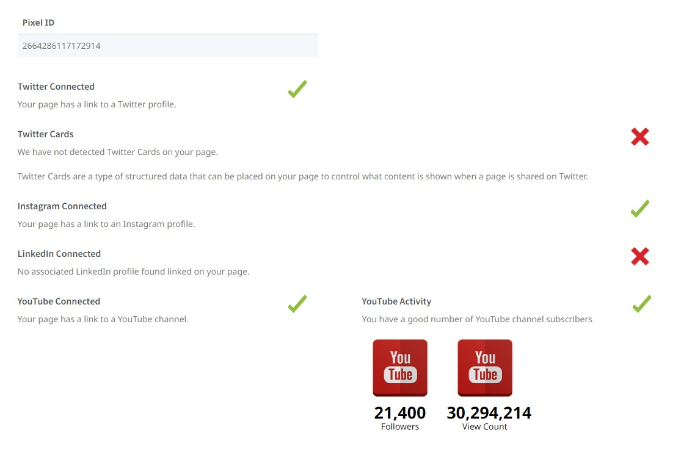

Slide 30
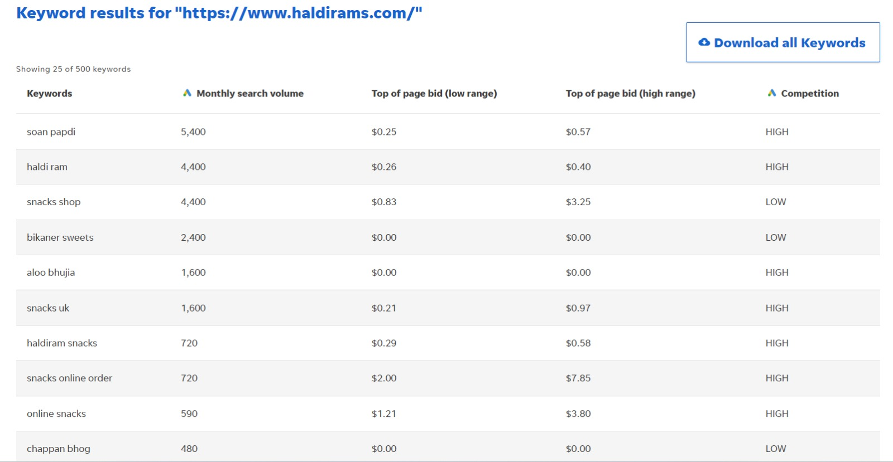
KEYWORD RESEARCH:

Slide 31
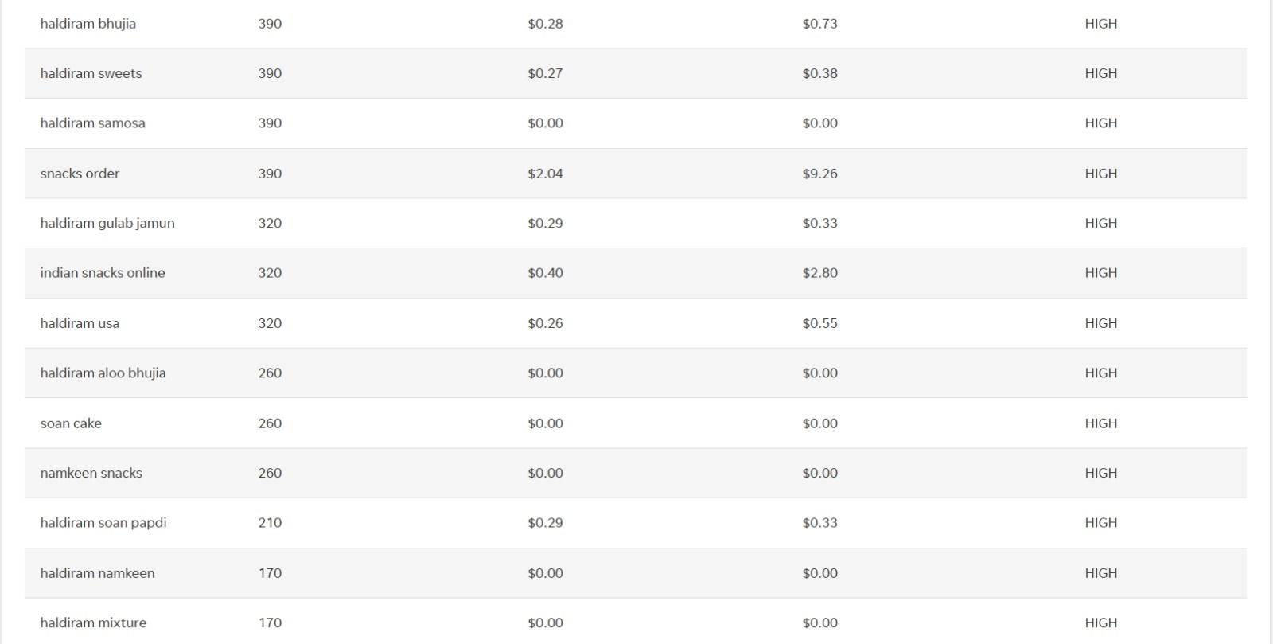

Slide 32
On page Optimization: Meta Tag optimization & content optimization.
Meta Title: "Delicious Indian Snacks & Sweets | Haldirams - Traditional Flavors, Unforgettable Taste“
Meta Description: "Indulge in the authentic taste of India with Haldirams. Explore a delightful selection of Indian snacks and sweets, crafted with time-honored recipes and premium ingredients. Order now for a taste experience like no other.“
CONTENT : At Haldirams, we take pride in preserving India's rich culinary heritage through our delectable range of Indian snacks and sweets. For decades, we have been sharing the traditional flavors of India with food enthusiasts worldwide.
Indian Snacks: Delight in a vast assortment of savory Indian snacks, from crispy namkeens to crunchy bhujia. Our snacks are made with care to satisfy your cravings and transport you to the streets of India.
Indian Sweets (Mithai): Celebrate joyous occasions with our mouthwatering selection of Indian sweets. From the rich flavors of Gulab Jamun to the divine taste of Rasgulla, our mithais are crafted to perfection.
Ready-to-Eat Meals: Experience the convenience of our ready-to-eat meals, inspired by traditional Indian recipes. Savor the taste of homely meals without any hassle.

Slide 33
AN ENCHANTING JOURNEY OF HALDIRAMS :Embark on an enchanting journey of Haldirams, where authentic flavors and delightful treats await to captivate your senses and take you on a culinary adventure like no other.
"The Haldirams Promise: A commitment to delivering the finest quality, authentic Indian snacks and sweets, crafted with love and tradition to bring you a taste experience that delights and satisfies every time."

Slide 34
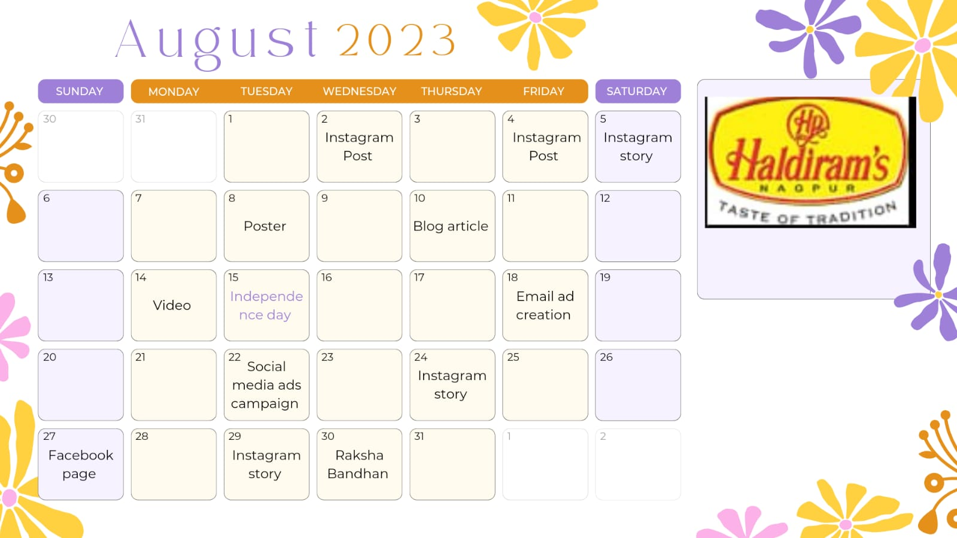
Part 3: CONTENT CALENDAR

Slide 35
Part 3: Content Ideas and Marketing Strategies
Reflect on the content ideas and marketing strategies process, discussing the challenges encountered and lessons learned.
Content ideas:
Recipe Videos: Create short and engaging recipe videos showcasing innovative ways to use Haldiram's products in cooking or as toppings for various dishes.
Festive Delights: Develop content around traditional Indian festivals, offering special festive gift packs, DIY decoration ideas, and unique sweets and snacks for each occasion.
Snack Hacks: Share fun and creative snack hacks using Haldiram's products, such as creating custom mixes, pairing snacks with dips, or incorporating them into other recipes.
Behind-the-Scenes: Give a sneak peek into the making of Haldiram's products, highlighting the brand's commitment to quality and hygiene.
Customer Stories: Feature heartwarming stories or testimonials from customers about their experiences with Haldiram's products and how it has been a part of their special moment .

Slide 36
Foodie Contests: Organize social media contests encouraging followers to share their favorite Haldiram's snacks creations, and reward the most creative entries.
Fun Facts: Share interesting and lesser-known facts about the ingredients used in Haldiram's products or the unique production processes.
Foodie Contests: Organize social media contests encouraging followers to share their favorite Haldiram's snacks creations, and reward the most creative entries.
Marketing Strategies Process:
Market Research: Conduct thorough market research to understand the current market trends, consumer preferences, and competitor landscape. Identify gaps and opportunities in the market that Haldiram's can leverage to its advantage.
Define Target Audience: Clearly define the target audience for Haldiram's products. Consider factors such as demographics, psychographics, behaviors, and preferences. This will help tailor marketing messages and campaigns to resonate with the right audience.
Brand Positioning: Craft a unique value proposition and position Haldiram's as a trusted and preferred brand in the snacks and sweets category. Emphasize the brand's heritage, quality, and variety of products.

Slide 37
Content Marketing: Develop a content marketing strategy that includes engaging and informative content such as recipe videos, snack hacks, customer testimonials, and behind-the-scenes content. Use different platforms like blogs, social media, and videos to reach a wider audience.
Social Media Strategy: Leverage social media platforms to connect with the target audience. Share visually appealing content, run interactive campaigns, respond to customer queries, and collaborate with influencers to increase brand visibility.
Festive and Seasonal Campaigns: Create special campaigns around Indian festivals and seasons, promoting festive-themed products, limited editions, and exclusive offers.
Customer Loyalty Program: Implement a customer loyalty program to reward repeat customers and encourage brand loyalty.
Partnerships and Collaborations: Collaborate with other brands, restaurants, or cafes to showcase Haldiram's products as part of special menus or joint promotions.

Slide 38
Discussing the Challenges Encountered and Lessons Learned:
Maintaining Quality and Consistency: As Haldiram's expanded its operations and reached a global market, maintaining consistent quality across all products became a challenge. The lesson learned here is the importance of investing in robust quality control measures and regular audits to ensure that the taste and quality of products remain consistent, regardless of the production location.
Changing Consumer Preferences: With evolving consumer tastes and health-consciousness, Haldiram's faced the challenge of adapting its product portfolio to cater to changing preferences. The lesson learned is the need for continuous innovation and introducing healthier snack options to align with evolving consumer demands.
Competition in the Snack Market: The snack market in India is highly competitive, with both local and international players vying for consumers' attention. Haldiram's had to find unique selling points and differentiate itself from competitors. The lesson learned is to focus on the brand's heritage, authenticity, and traditional recipes to stand out in the market.
Supply Chain and Logistics: As Haldiram's expanded its distribution network, managing the supply chain and logistics efficiently became crucial. The lesson learned is the importance of optimizing logistics, reducing lead times, and ensuring timely delivery to meet customer expectations.

Slide 39
Part 4: Content Creation and Curation (Post creations, Designs/Video Editing, Ad Campaigns over Social Media and Email Ideation and Creation)
Post Creation:
Select Content Categories: Identify three different content formats relevant to the chosen topic or industry. Research and Brainstorm: Research trending topics, industry news, or audience interests within each category. Brainstorm ideas for social media posts that align with each category. Do note that 1 content format has to be video and additionally 3 stories/status are to be created.
Format 1: BLOG ARTICLE
Format 2: VIDEO
Format 3: POSTER

Slide 40

BLOG ARTICLE ON HALDIRAM’S
BLOG ARTICLE DATE : 10-08-2023
AIM: To offer a diverse range of authentic and delectable snacks and sweets.
Title: Haldiram's: A Flavorful Journey of Tradition, Taste, and Global Success
Introduction: When it comes to savory snacks and mouthwatering sweets that capture the essence of Indian cuisine, one name that stands out is Haldiram's. With a rich heritage spanning decades, Haldiram's has become an iconic brand synonymous with quality, tradition, and delightful flavors. In this blog article, we embark on a flavorful journey through the history, values, and global success of Haldiram's.
A Legacy of Tradition: Haldiram's was founded in 1937 as a small sweet shop in Bikaner, Rajasthan, by Shri Ganga Bhishen Agarwal. The shop soon gained popularity for its delectable sweets prepared with time-honored recipes passed down through generations. The brand's commitment to preserving traditional flavors remains a cornerstone of its success to this day.

Slide 41
From Humble Beginnings to Global Presence: Over the years, Haldiram's expanded its offerings beyond sweets, introducing an extensive range of namkeens (savory snacks), packaged food items, and ready-to-eat meals. The brand's commitment to quality, hygiene, and authentic flavors quickly earned it a loyal customer base not only across India but also in various countries worldwide.
Authenticity at Its Core: What sets Haldiram's apart from its competitors is its unwavering dedication to authenticity. Each product is carefully crafted with premium ingredients, keeping the essence of Indian flavors intact. From the traditional aloo bhujia to the delectable rasgulla , Haldiram 's products evoke a sense of nostalgia and cultural pride for consumers.
The Festive Connection: Haldiram's has become an integral part of Indian festivities and celebrations. During festivals like Diwali, Raksha Bandhan, and Holi, Haldiram's sweet and savory treats grace millions of households, adding joy to every occasion. The brand's festive packaging and special offerings create a unique and memorable experience for its customers.
Global Expansion and Local Adaptation: Haldiram's successfully ventured into international markets, making its mark in countries like the United States, United Kingdom, Australia, and the Middle East. However, the brand's global success is not just about exporting products; it involves understanding the unique tastes and preferences of each region and customizing offerings to suit local palates.

Slide 42
Innovating for Health-Conscious Consumers: As health-consciousness continues to rise, Haldiram's has adapted its product portfolio to offer healthier alternatives without compromising on taste. The brand introduced baked snacks, low-sugar sweets, and gluten-free options to cater to the evolving demands of modern consumers.
The Sweetness of Social Responsibility: Beyond the business of snacks and sweets, Haldiram's has actively participated in various corporate social responsibility initiatives. From supporting local communities to promoting sustainable practices, the brand demonstrates its commitment to giving back to society.
. Digital Footprint and Customer Engagement: In this digital age, Haldiram's has made its presence felt across various online platforms. Engaging content, interactive campaigns, and prompt customer service have helped the brand create a robust online community of loyal patrons
Conclusion: Haldiram's has undoubtedly left an indelible mark on the hearts and taste buds of millions, both in India and around the world. Its journey from a modest sweet shop to a global snacking giant is a testament to its dedication to tradition, quality, and innovation. As Haldiram's continues to spread the joy of flavors, it remains a beacon of Indian culture and a symbol of pride for all those who savor its timeless treats.

Slide 43

VIDEO:
DATE: 06-08-2023
AIM: To showcase the irresistible appeal of their delectable snacks and sweets, highlighting their commitment to quality, tradition, and the joy they bring to people's lives.
LINK
https://www.instagram.com/reel/CvUiahqAW6c/?utm_source=ig_web_copy_link&igshid=MzRlODBiNWFlZA==

Slide 44
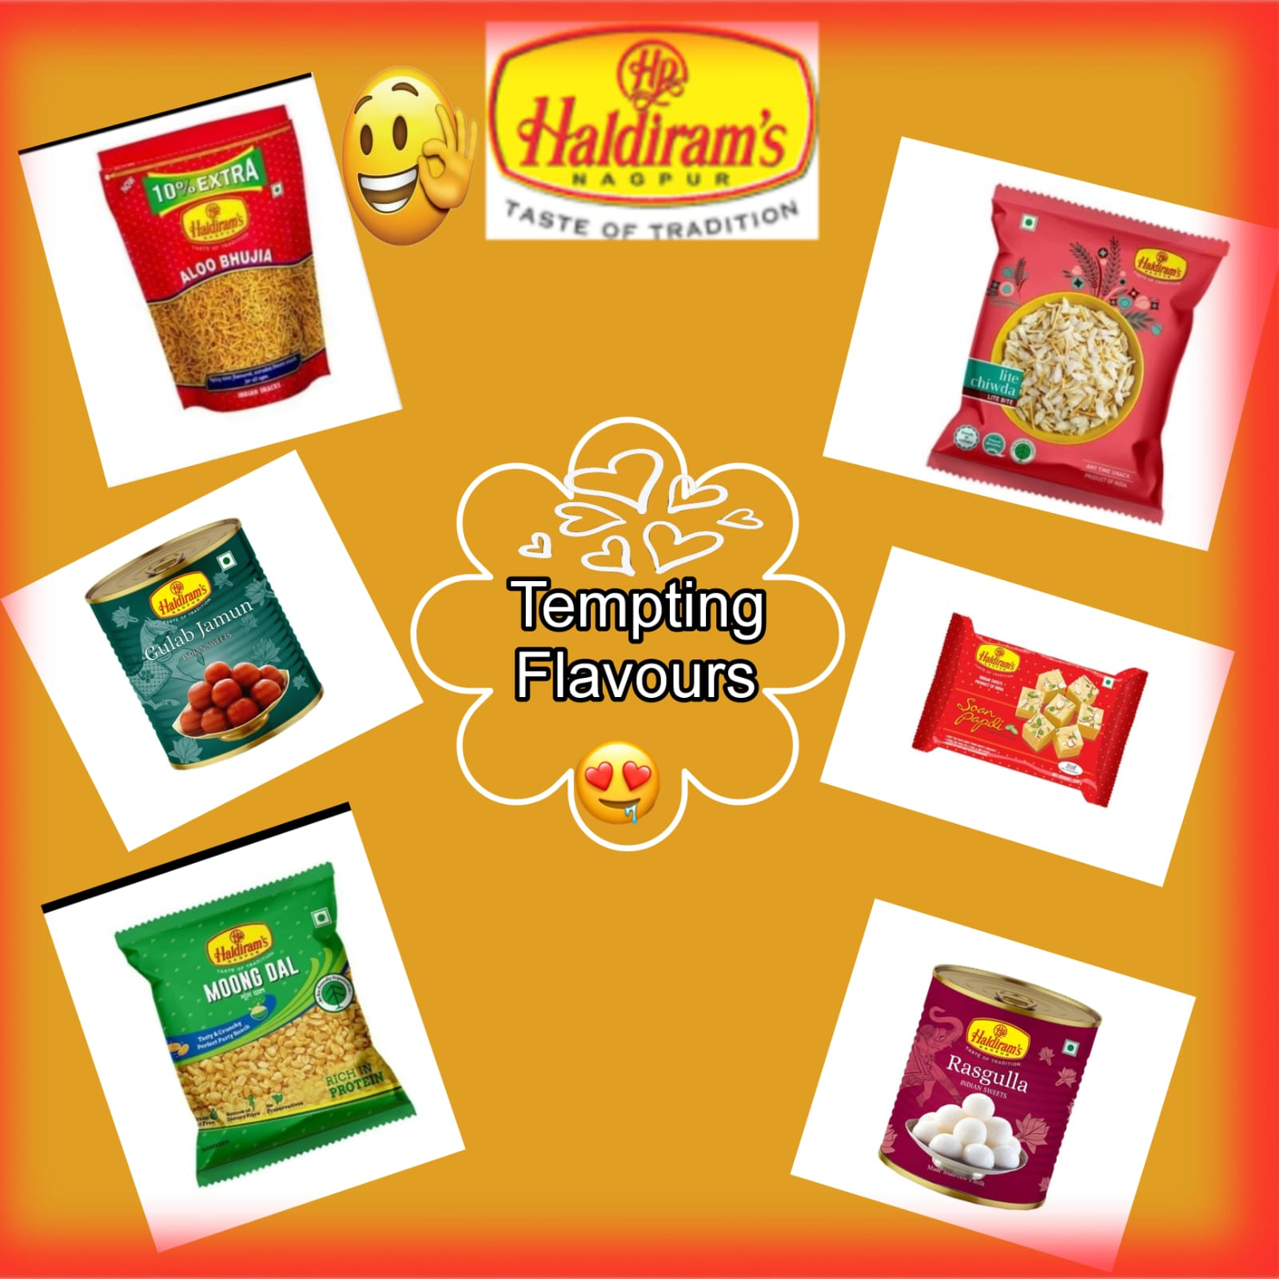
POSTER:
DATE: 08-08-2023
AIM: TO SHOWCASE THE PRODUCTS OF THE HALDIRAMS

Slide 45
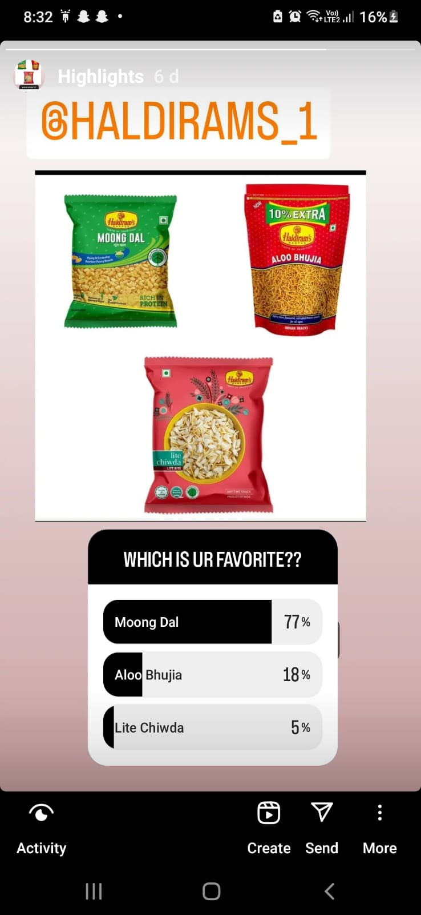
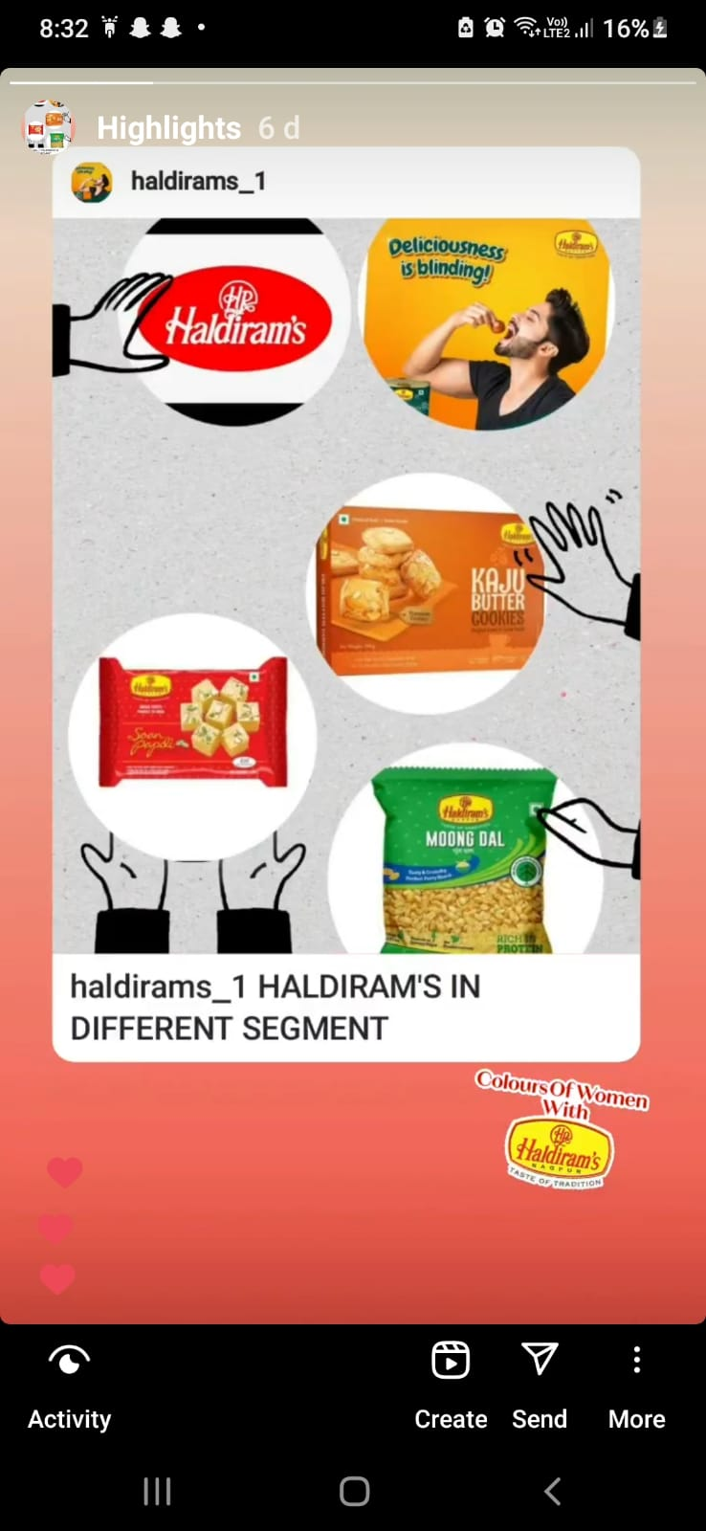
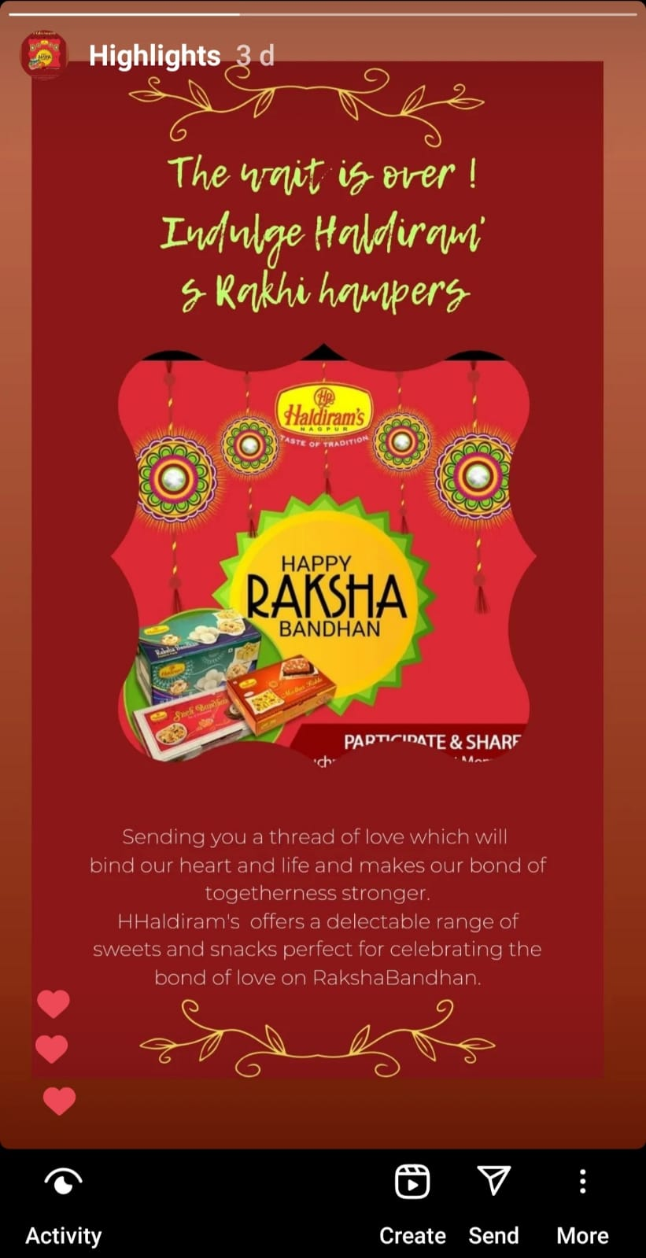
Instagram Story

Slide 46
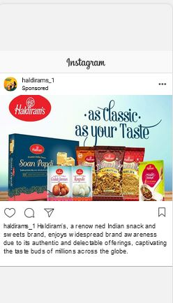
SOCIAL MEDIA AD CAMPAIGNS:
BRAND AWARENESS :
Advertising Goal: To increase brand awareness
Targeting: location-India , all genders
Age- 18 to 75
Snacks and sweets, adored for their
authentic taste and quality, making every
occasion a delightful experience.

Slide 47
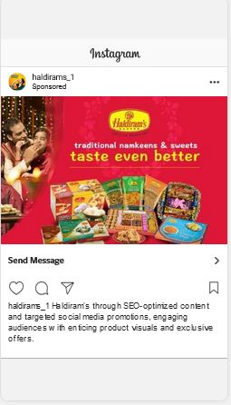
Driving Website Traffic:
Advertising Goal: To increase website traffic
Targeting: location-India , all genders
Age- 18 to 75
Snacks and sweets, adored for their
authentic taste and quality, making every
occasion a delightful experience.

Slide 48
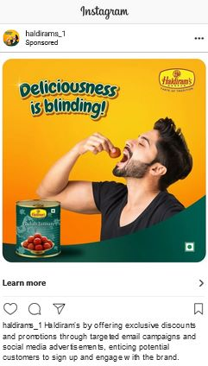
Generating Leads :
Advertising Goal: To increase website traffic
Targeting: location-India , all genders
Age- 18 to 75
Snacks and sweets, adored
for their authentic taste and
quality, making every occasion a
delightful experience

Slide 49
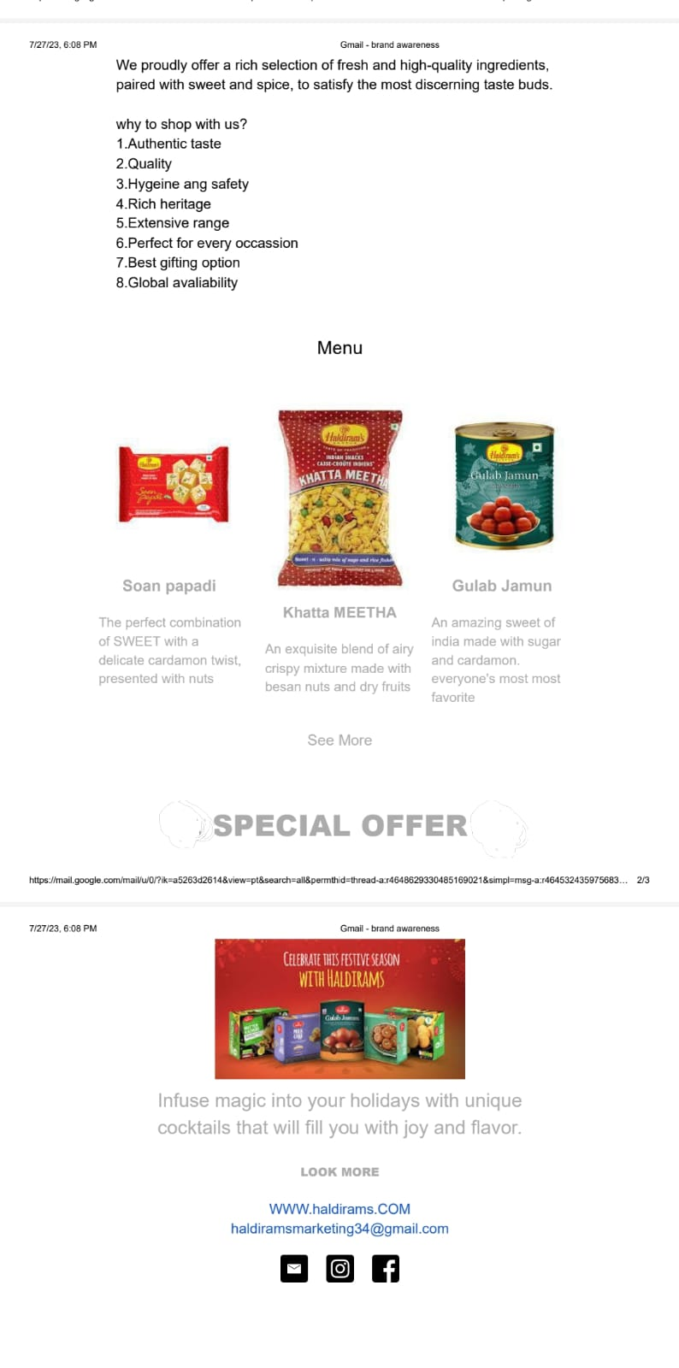
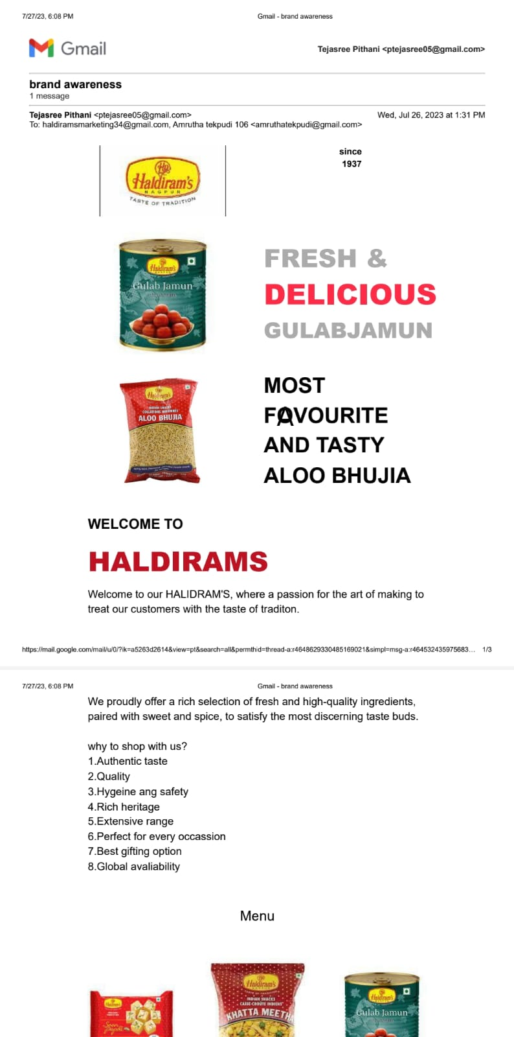
Email Ad Campaign

Slide 50
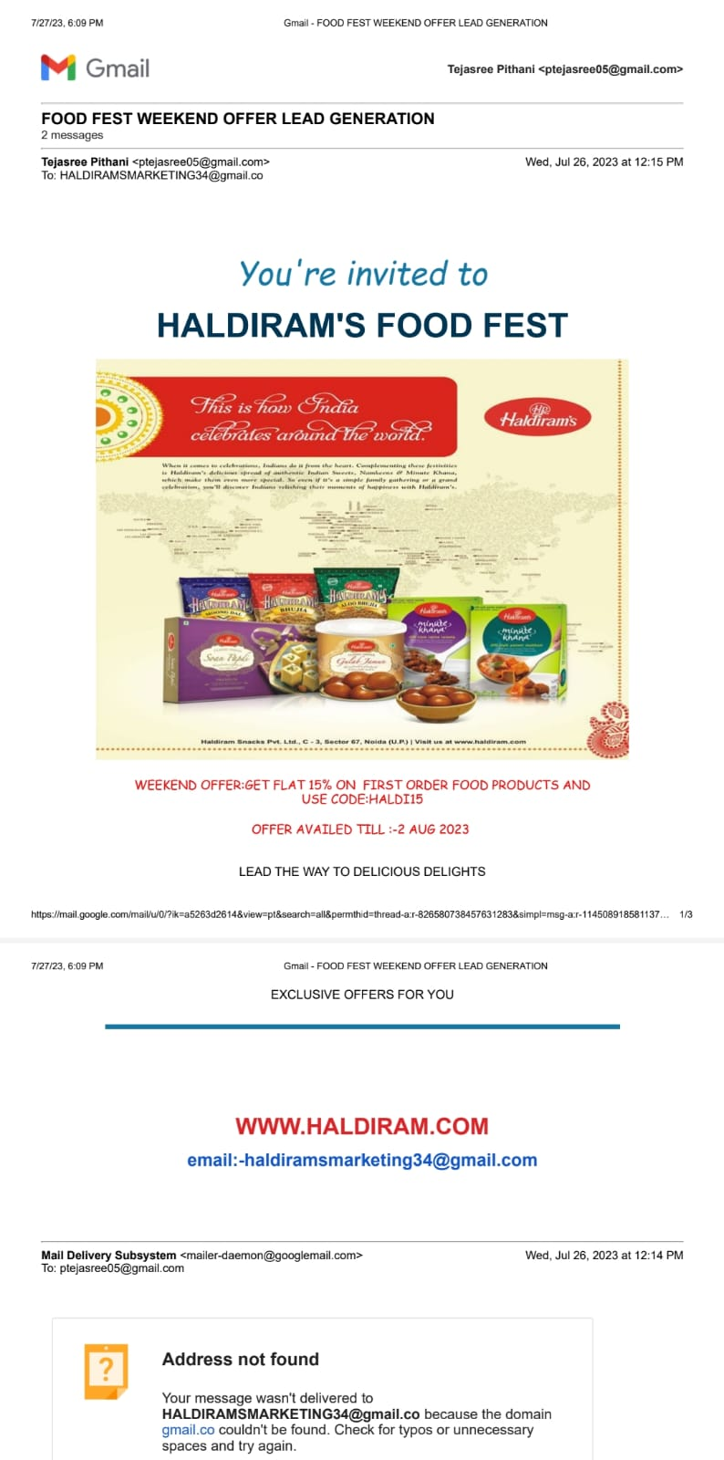
Lead Generation

Slide 51
Part 4: Content Creation and Curation (Post creations, Designs/Video
Editing, Ad Campaigns over Social Media and Email Ideation and Creation)
Reflect on the content creation and curation process, discussing the challenges faced and lessons learned.
Content creation and curation play a pivotal role in Haldiram's marketing strategy, enabling the brand to
connect with its audience, build brand awareness, and drive customer engagement. However, like any
content-driven endeavor, this process comes with its own set of challenges and valuable lessons.
Challenges faced :
Showcasing variety: Presenting numerous products cohesively.
Cultural sensitivity: Addressing diverse tastes and customs.
Brand consistency: Maintaining unified messaging.
UGC curation: Managing user-generated content effectively.
Negative feedback: Handling criticism professionally.
Lessons Learned:
Use multimedia for variety display.
Tailor content for local audiences.
Develop brand guidelines for consistency.
Engage customers for UGC and loyalty.
Address feedback constructively for improvement.

